Slide 1

airbnb
Book Rooms With Locals, Rather than Hotels

Slide 2
Overview
01
Staring
Dataset
02
Business Question
03
DFM
Dimensional
Fact Model
04
ETL
Process
Dash-boards
06
Color
Blindness
Test
05

Slide 3
Starting Dataset
Calendar
Listing
Listing_id
Date
Available
Price
Adjusted_price
Minimum_nights
Maximum_nights
Id
Name
host_id
host_name
neighbourhood_group
Neighbourhood
Latitude
Longitude
room_type
Price
minimum_nights
number_of_reviews
last_review
reviews_per_month
calculated_host_listings_count
availability_365
number_of_reviews_ltm
license
airbnb
Sicily, Italy – March 2023
Reviews
Listing_id
Date
Neighbourhood
Neigbourhood
Neigbourhood_group

Slide 4

Question 01
How does the average price and count of review differ for different room types with in a specific city?
Business
Questions
Question 02
What is the distribution of room type in different cities with respect to average price & reviews?
Question 03
Which month experience the highest demand booked listing for each room type?

Slide 5
Question 04
What are the seasonal trends in booking behavior?
Business
Questions
Question 05
Where one or few cities dominate the market in term of listing percentage?
Question 06
What are the trend in the number of reviews over the past 10 years and how it been impact by covid-19 pandemic?

Slide 6
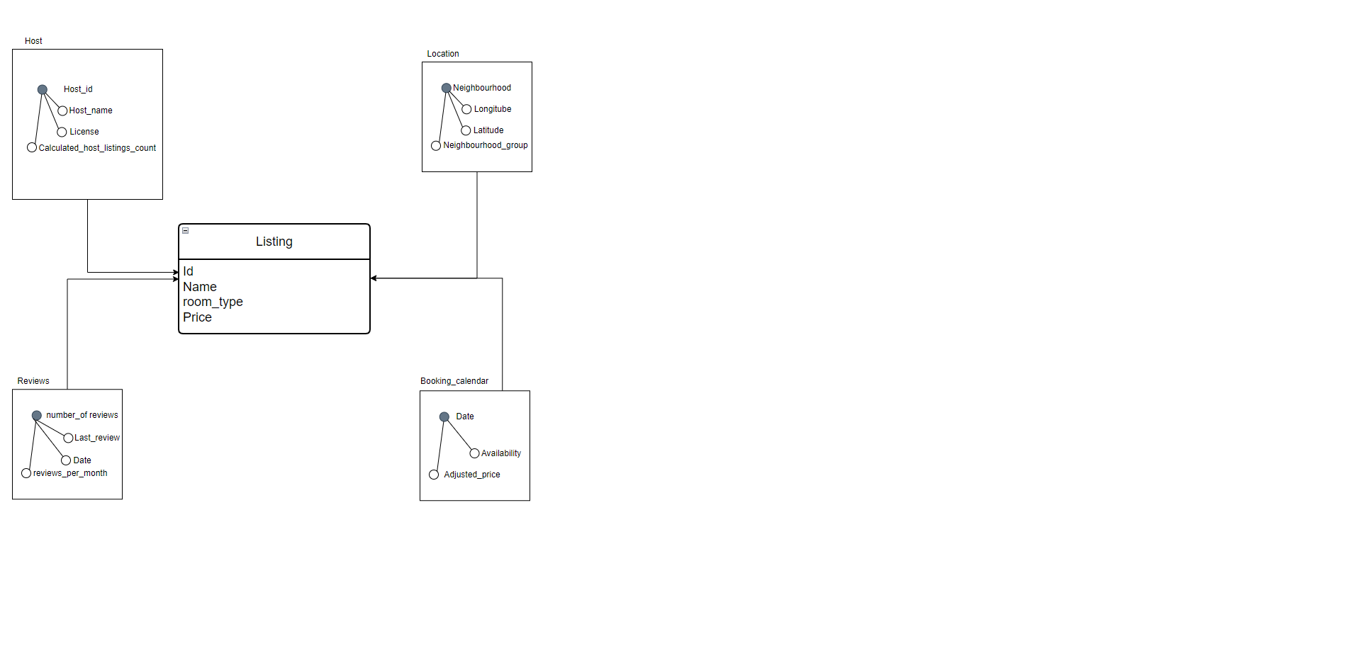
Dimensional Fact Model

Slide 7
Reviews
01
Remove Field Source Row numbers – Auto-generated field
Neighborhood
01
Remove Field Source Row numbers – Auto-generated field
ETL
Process
02
Remove neighborhood group column from the dataset – because it’s clearly show that column haven’t any value
Calendar
01
Remove Field Source Row numbers – Auto-generated field
02
Due to very big data in this CSV file so we apply sampling technique that we collection 100,000 rows and quickest

Slide 8
01
Remove Field Source Row numbers – Auto-generated field
02
Remove neighborhood group column from the dataset – because it’s clearly show that column haven’t any value
03
Remove last review column from the dataset. useless column for us
ETL
Process
04
Empty BNB’s name (null value) replaces with Unspecified
05
Empty BNB’s host’s name (null value) replaces with Unspecified
Listing
06
Empty count of reviews per month (null value) replaces with zero
07
Remove License column from the dataset – having too much garbage data
08
Round off reviews per month

Slide 9
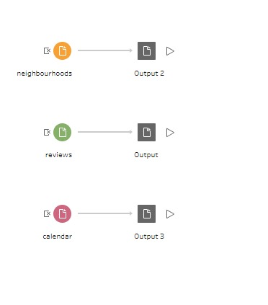
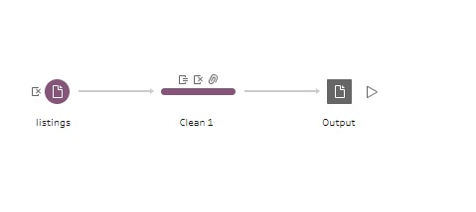
ETL
Process
Diagram

Slide 10


Dashboards

Slide 11


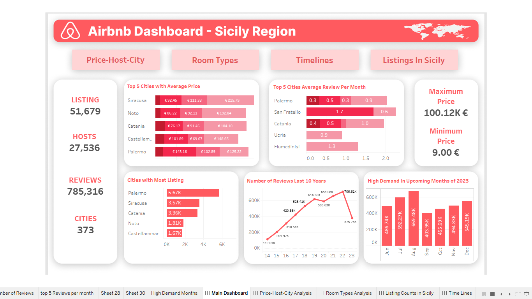
Main Dashboard

Slide 12
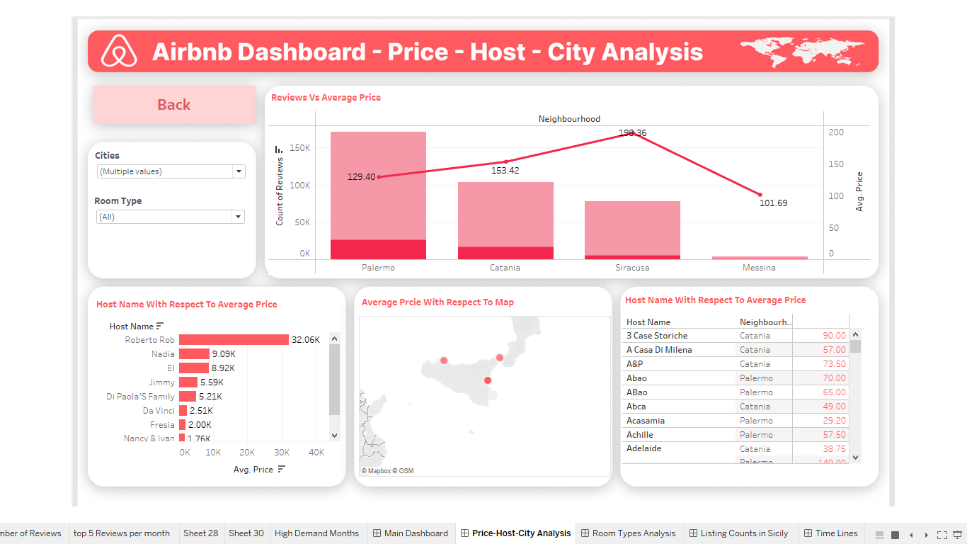
Price – Host – City Analysis

Slide 13
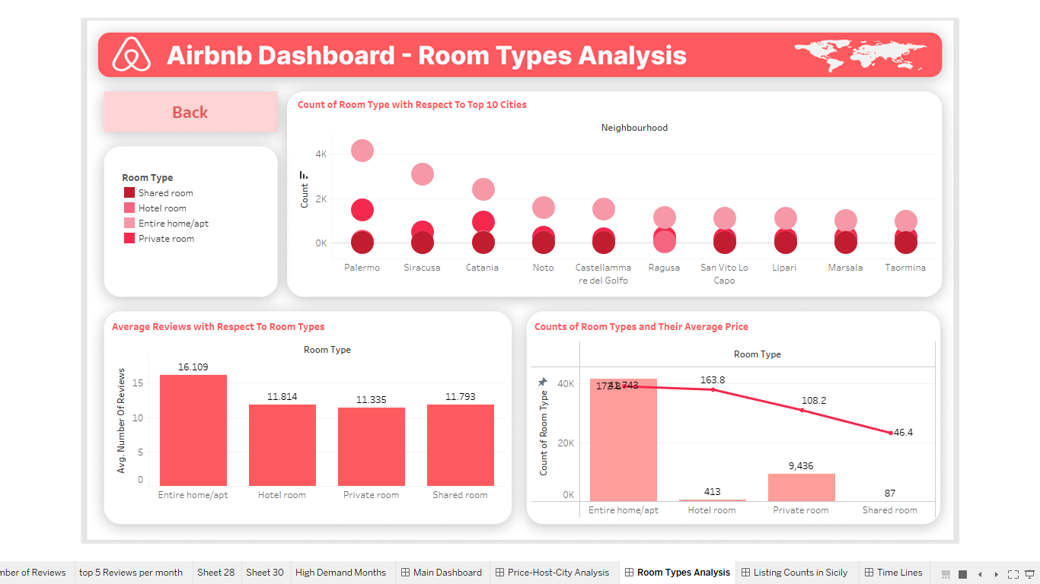
Room Type Analysis

Slide 14
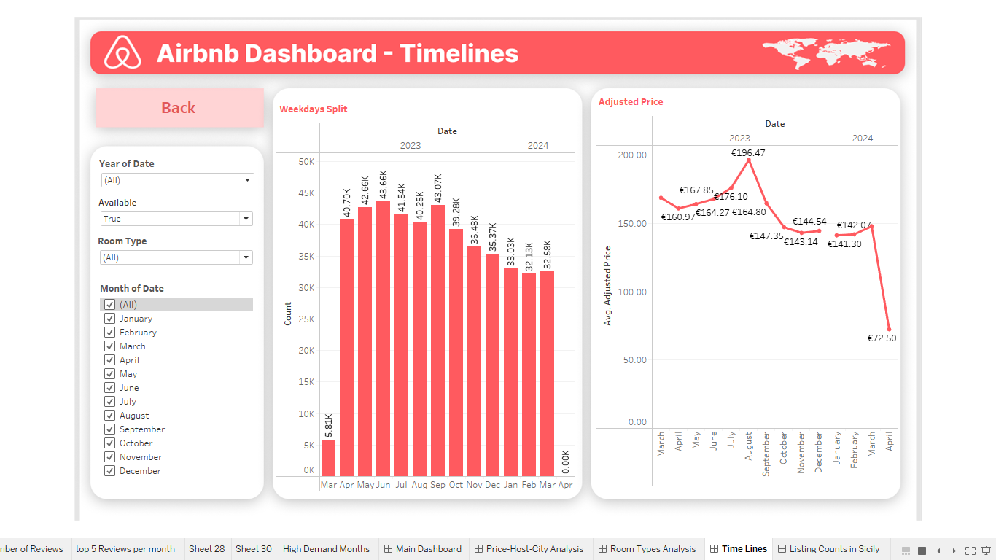
Timelines

Slide 15
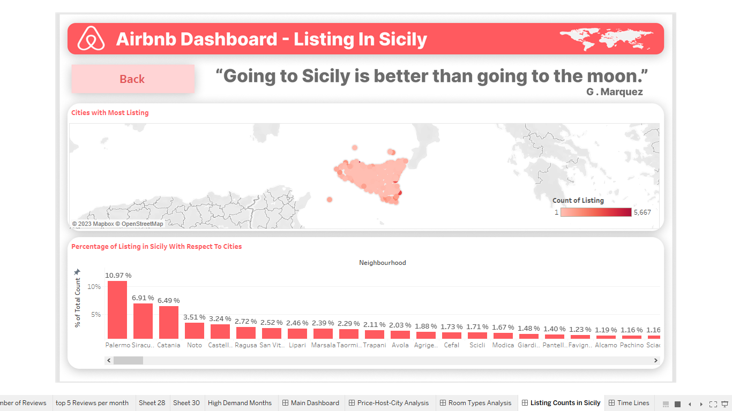
Listing in Sicily

Slide 16
Hotel Rooms & Private Rooms
Are more cheaper in Catania as compare to average price in rest of the Sicily.
Conclusion
Room Type | Average Price in CT | Average Price in Sicily
Entire Home / Apartment | 184.10 Euro | 172.8 Euro
Hotel Room | 91.45 Euro | 163.8 Euro
Private Room | 76.17 Euro | 108.2 Euro
Shared Room | 40.60 Euro | 46.4 Euro

Slide 17
Highest Distribution W.R.T
Listing
Room Type | Listing count | City | Average Price | Average Review
Entire Home / Apartment | 4140 | Palermo | 125.2 Euro | 35.00
Hotel Room | 53 | Palermo | 102.9 Euro | 18.19
Private Room | 1459 | Palermo | 143.2 Euro | 17.38
Shared Room | 15 | Palermo | 40.6 Euro | 9.20

Slide 18
39.85k
April
Highest Demand
Advance Booked
Listing
2023
32.78k
August
30.52k
July

Slide 19



Seasonal Trends W.R.T
Average Adjusted Price
196.47€
176.10 €
167.85 €
August 2023
July 2023
June 2023

Slide 20




Dominate Cities
Listing Percentage
According the google, Taormina is the most beautiful and visited place in Sicily.
But Unfortunately, Have low numbers of listing.
10.97%
6.91%
6.49%
Palermo
Syracuse
Catania

Slide 21
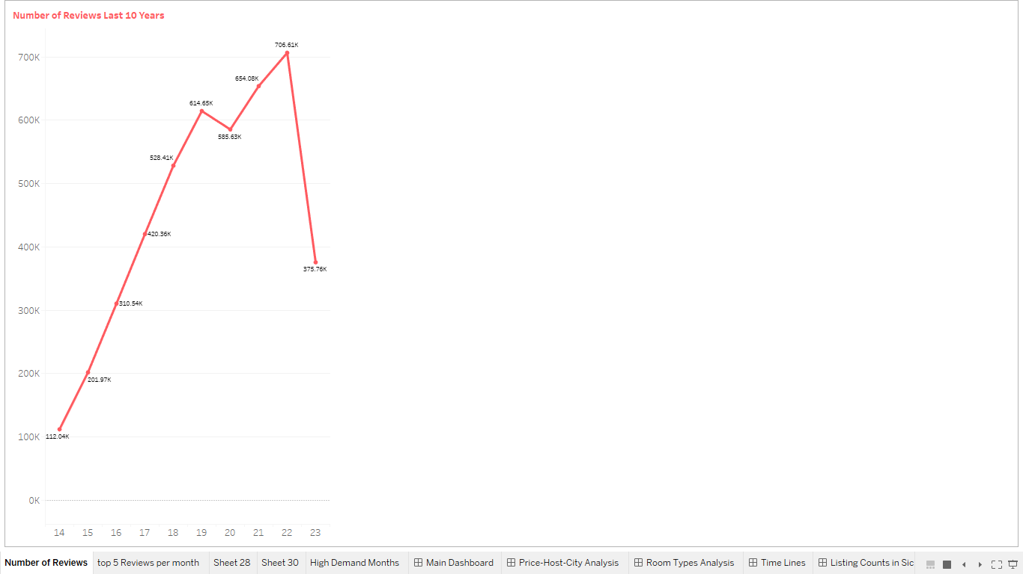
Total Review
Past 10 Years
654.08k
2021
According to the graph, every year the number of reviews almost increase by 100k.
However, the impact of pandemic cost a dramatically dropped in the trend.
585.63k
2020
614.65k
2019

Slide 22
Color Blind Test

Slide 23
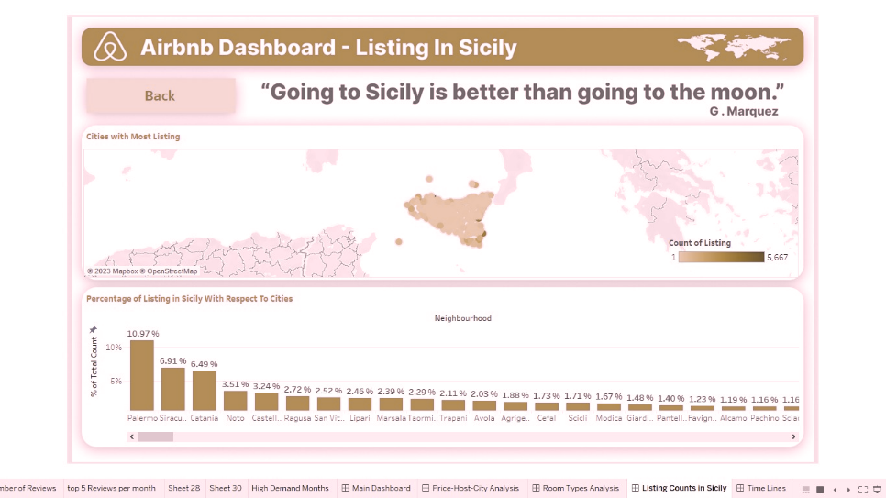
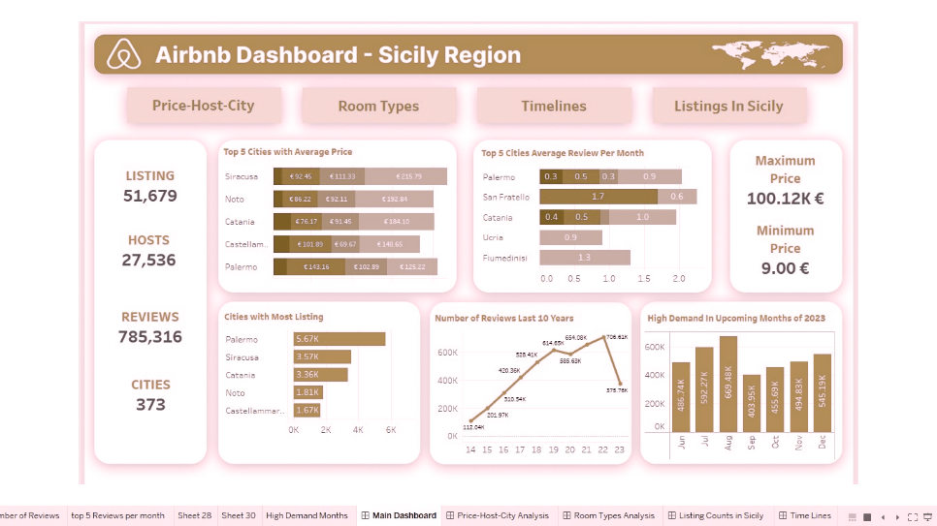
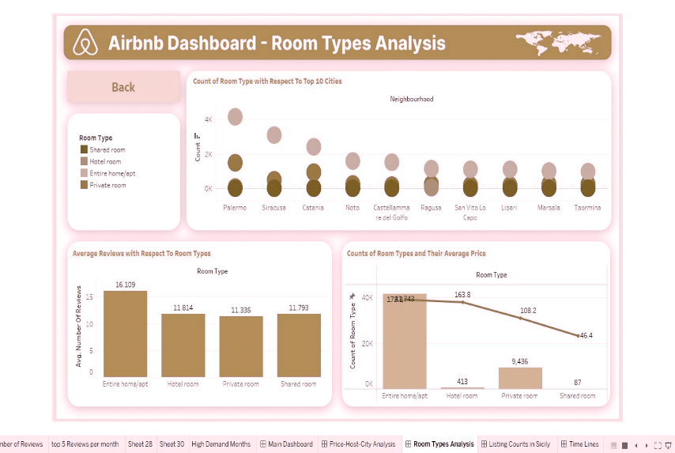
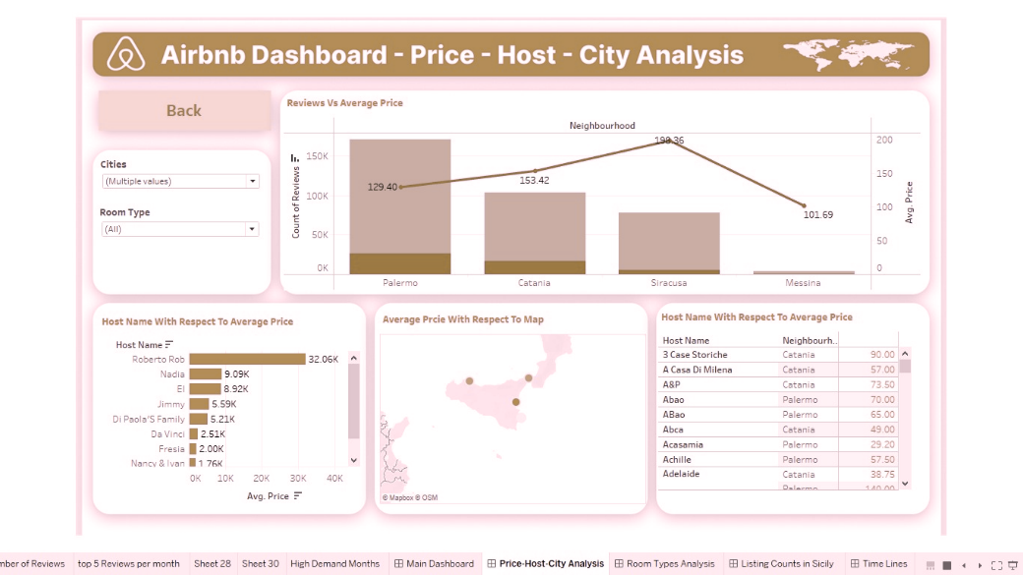
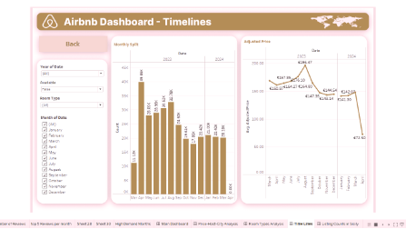
Green Blind

Slide 24
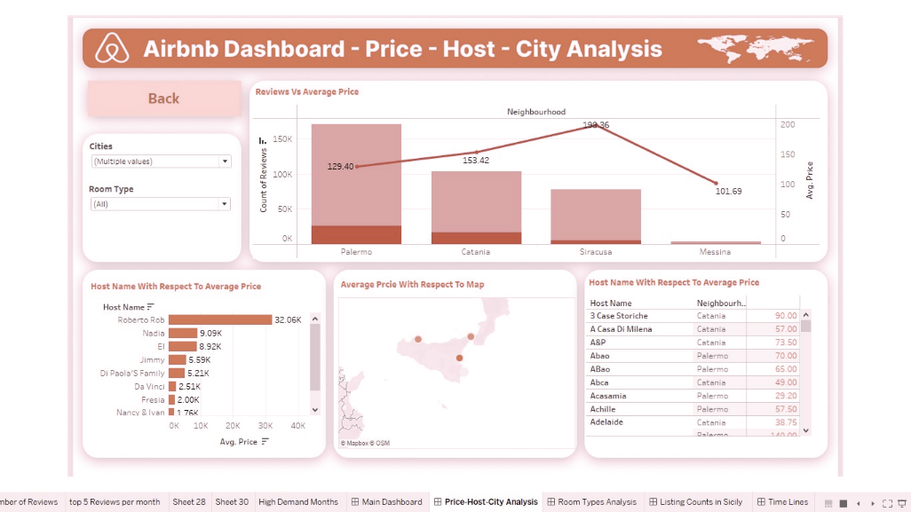
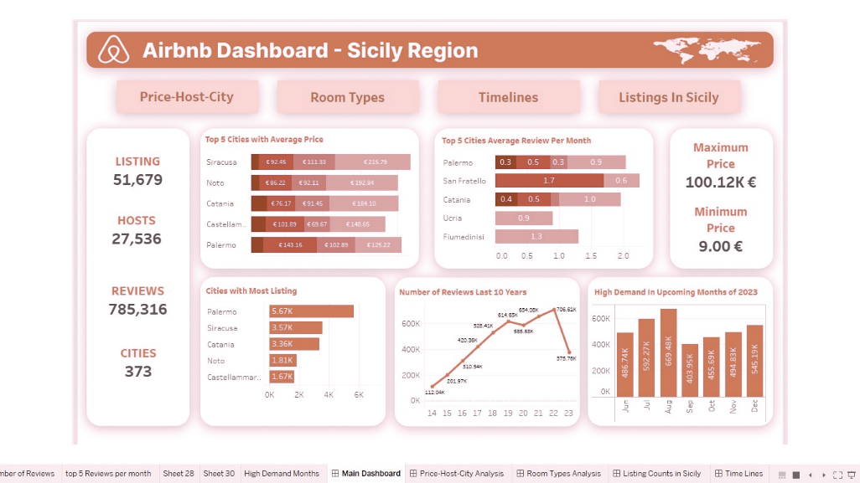
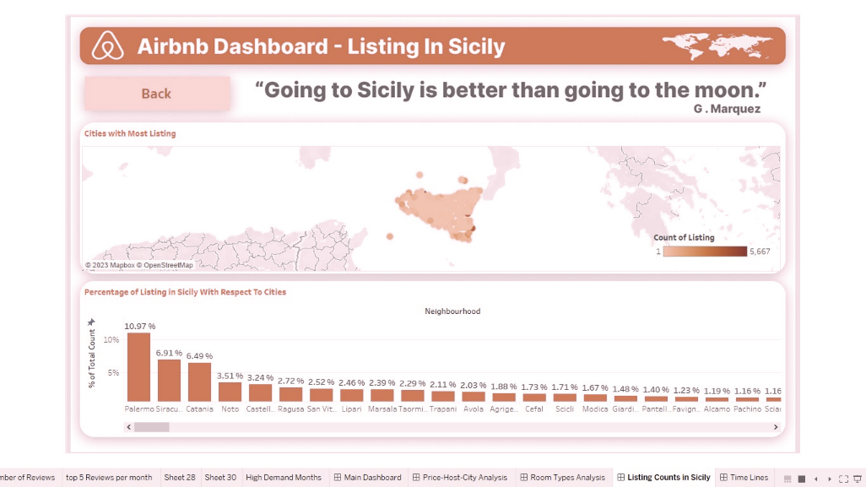
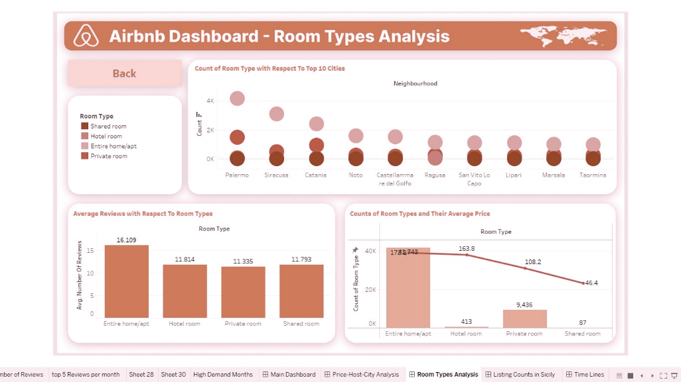
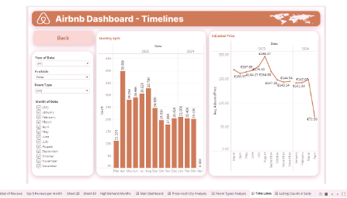
Green Weak

Slide 25
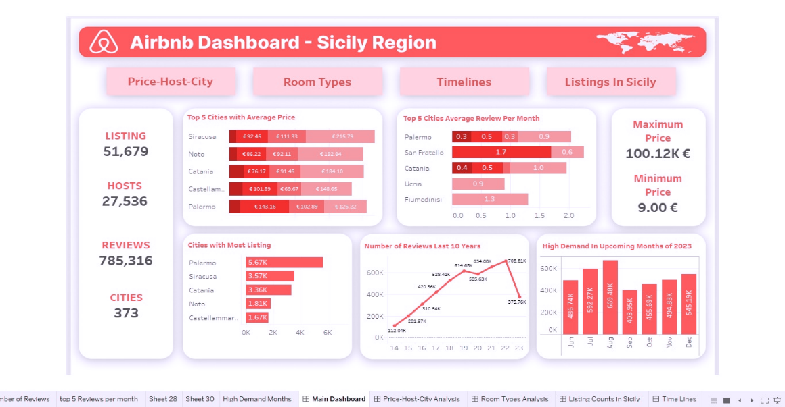
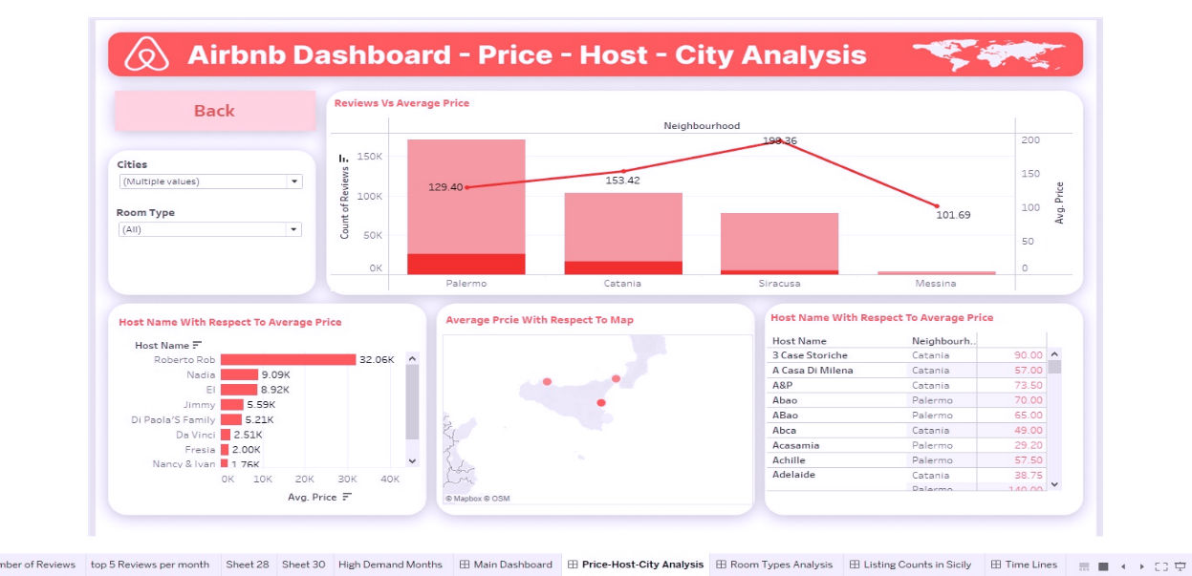
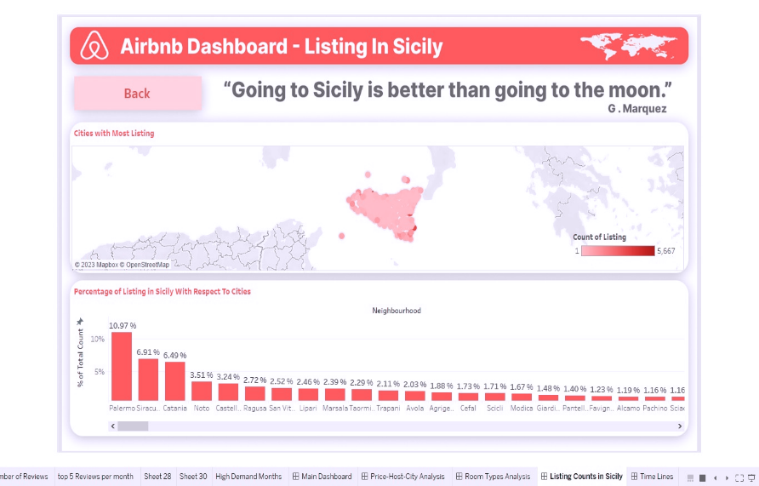

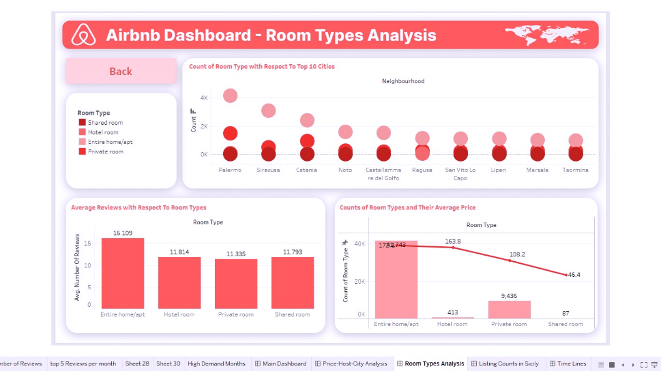
Blue Blind

Slide 26


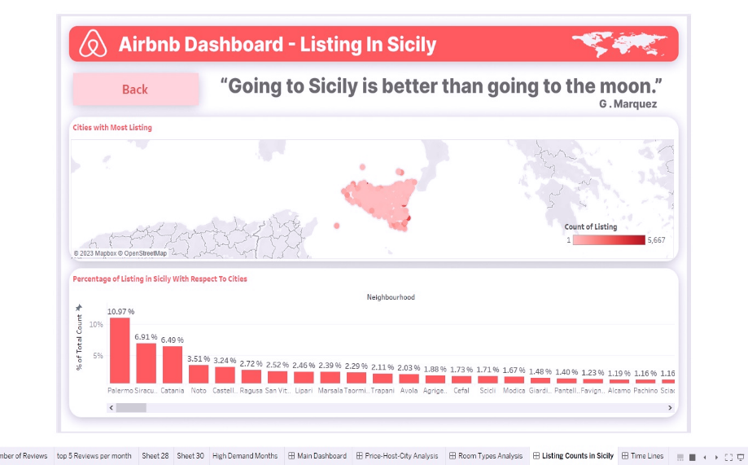


Blue Weak

Slide 27
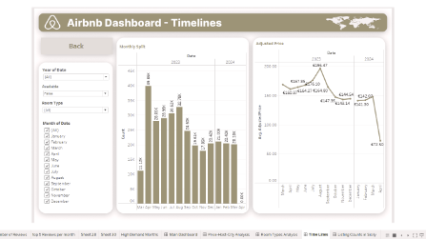
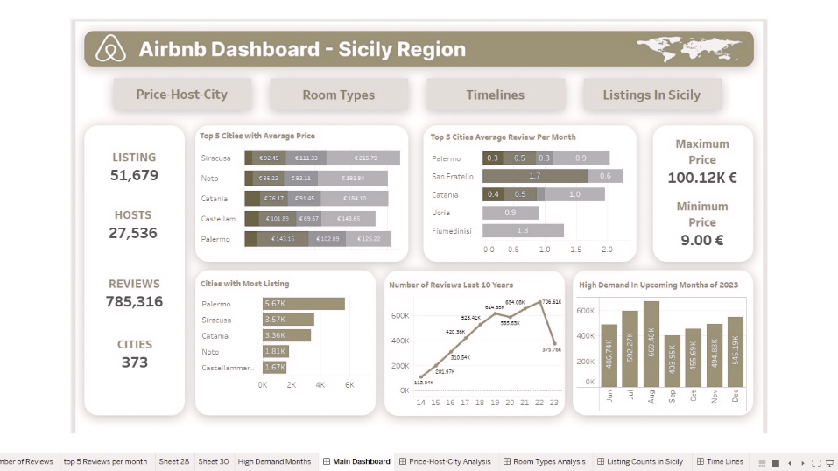
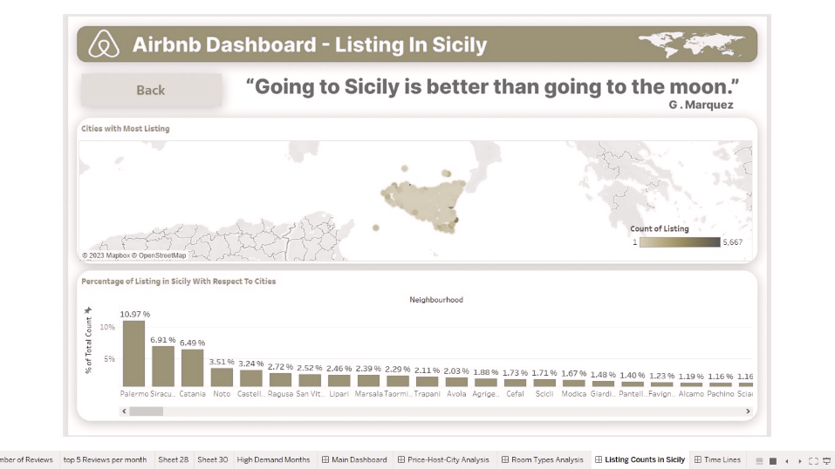
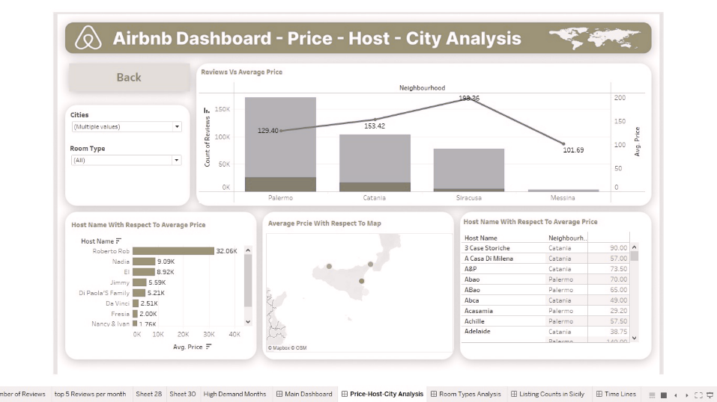
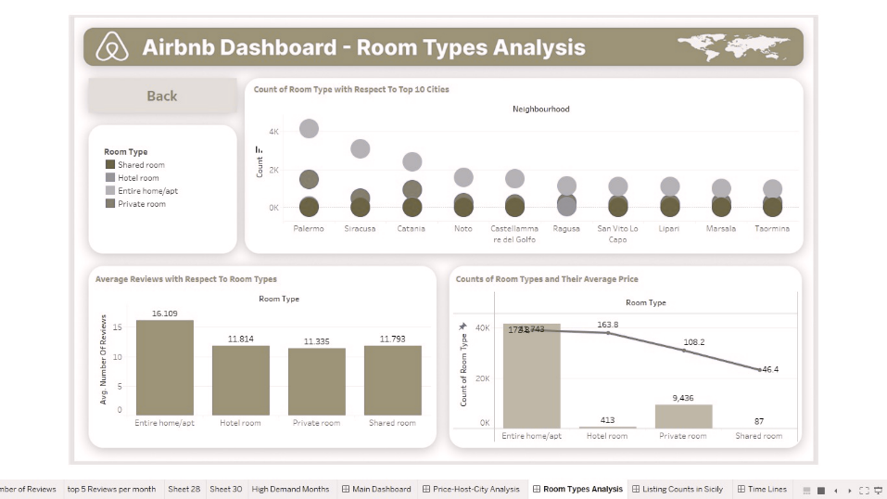
Red Blind

Slide 28
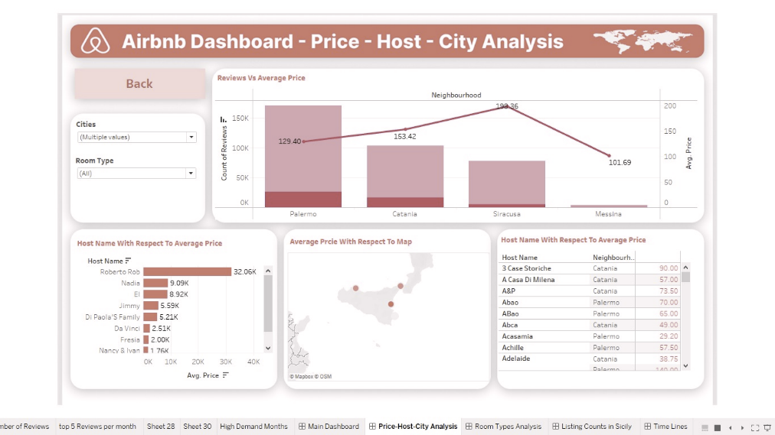
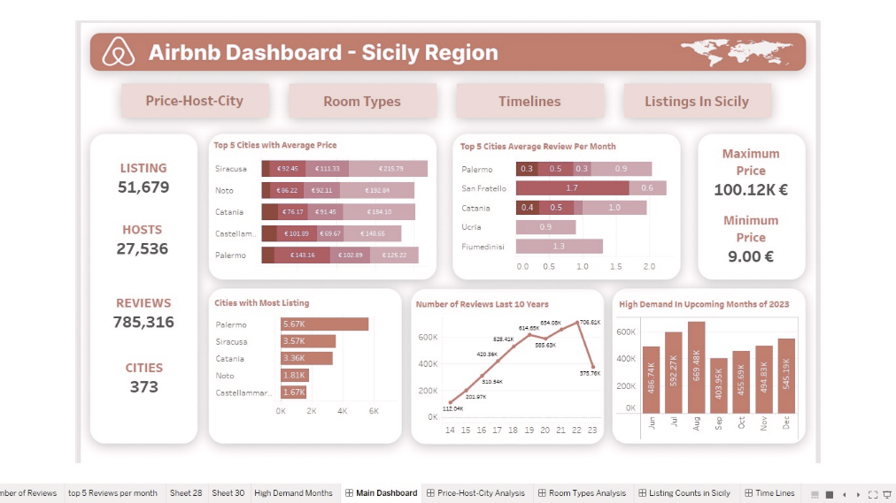


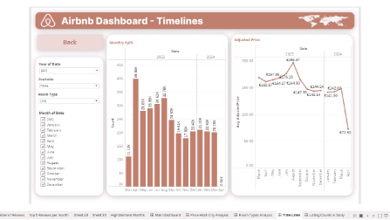
Red Weak

Slide 29
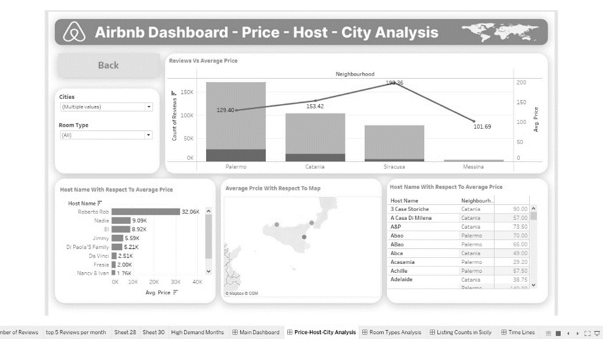
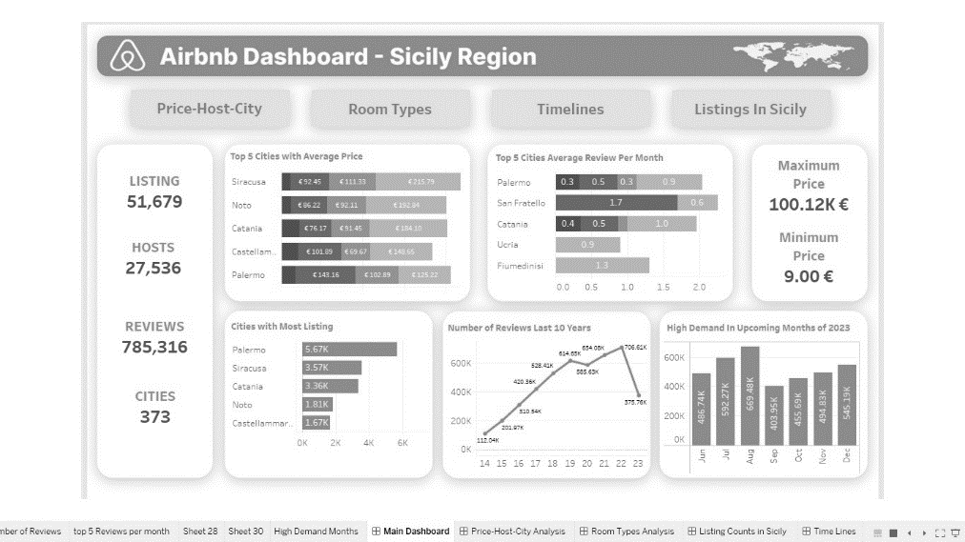
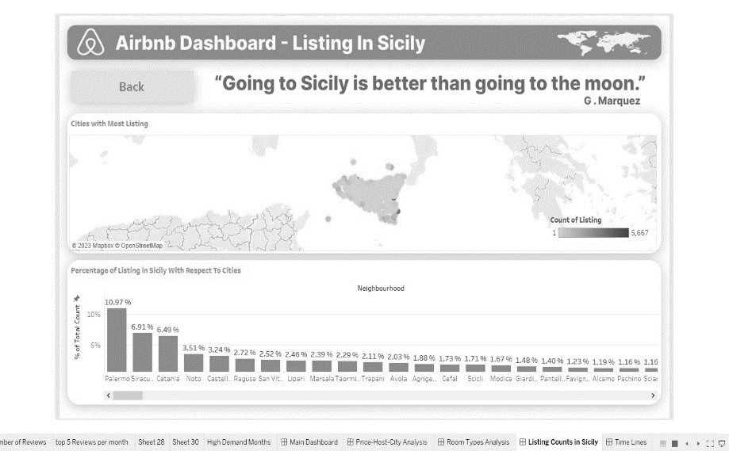
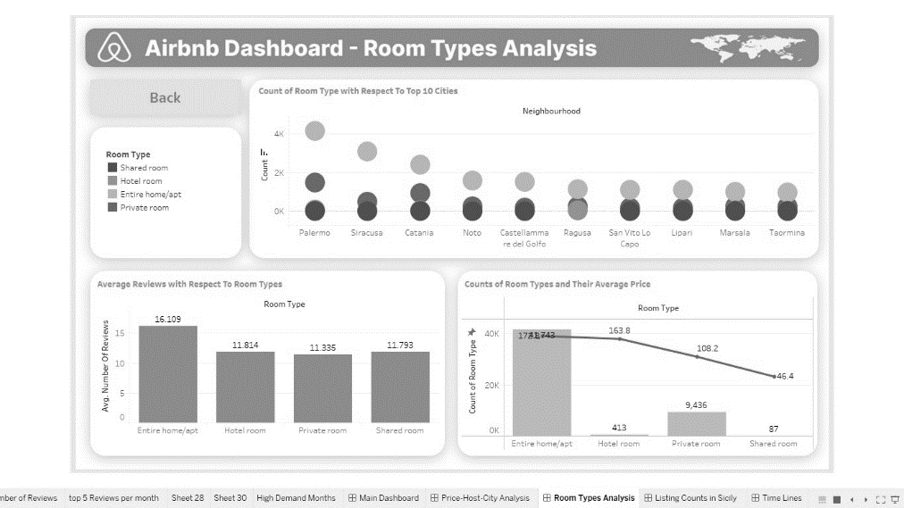
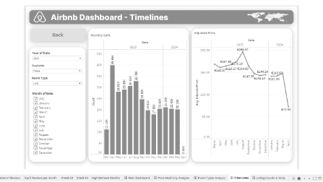
Mono

Slide 30




Our Team
Sameer Afzal
Harsh Mehta
Asad Aslam
1000053142
1000055155
1000053142
Thank You

